Slide 1


PRINCE DR. K. VASUDEVAN COLLEGE
OF ENGINEERING AND TECHNOLOGY
Department of Computer Science and Engineering
TITLE
FUEL PULSE : Digital Fuel Logistics Revolutionizing Delivery Management
Domain : Android Application
PDKVCET
Guided By :
Mrs:Keerthiga.A M.E
Assistant Professor
Coorinated By :
Mrs: Shalini.S M.E(Ph.d)
Head of department CSE
Presented By :
V Arul kumar
Reg. No : 411620104001
S Surya
Reg. No : 411620104020

Slide 2
AIM AND OBJECTIVE
We aim to revolutionize delivery management through "Digital Fuel Logistics" by leveraging cutting-edge technology, optimizing logistics, and ensuring seamless, on-demand fuel delivery services.
The On-Demand Fuel Delivery System aims to revolutionize the refueling experience by offering a seamless and efficient solution through a user-friendly mobile app.
Our primary objective is to provide customers with the convenience of ordering fuel from their location without the need to visit traditional fuel stations.
PDKVCET

Slide 3
ABSTRACT
The On-Demand Fuel Delivery System revolutionizes the way customers refuel by offering a seamless and convenient mobile app experience. With just a few taps on their smartphone, users can effortlessly order fuel to be delivered directly to their location, eliminating the hassle of visiting traditional fuel stations. This user-friendly app allows customers to specify their location and desired quantity of fuel, providing a tailored and personalized service to meet their exact needs. Whether they're at home, work, or on the go, users can rely on the On-Demand Fuel Delivery System to ensure they never run out of fuel. Gone are the days of waiting in line at gas stations or worrying about inconvenient refueling stops during busy schedules. With this innovative solution, customers can enjoy the convenience of fuel delivery at their fingertips, saving time and effort while ensuring they always have the fuel they need to keep moving forward.
PDKVCET

Slide 4
EXISTING SYSTEM
The existing fuel distribution system often requires customers to visit traditional fuel stations to refill their vehicles, which can be inconvenient and time-consuming, especially during busy periods or when stations are located far away.
Moreover, traditional fuel stations have limited operating hours, which may not align with customers' needs, particularly during emergencies or late-night hours.
This lack of accessibility can lead to frustration and inconvenience for customers who require fuel outside of standard operating hours.
PDKVCET

Slide 5
DISADVANTAGES IN EXISTING SYSTEM
A disadvantage of ordering fuels through phone calls is the potential for miscommunication, leading to errors in the type or quantity of fuel delivered.
Phone orders may lack real-time tracking features, making it challenging for customers to monitor the status and expected delivery time.
Busy phone lines can lead to delays in placing orders, impacting the efficiency of fuel delivery services.
PDKVCET

Slide 6
PROPOSED SYSTEM
The proposed On-Demand Fuel Delivery System presents a comprehensive solution to the drawbacks of the current fuel distribution model.
This approach not only saves time but also offers unparalleled accessibility, with round-the-clock delivery options available to various locations, including homes, workplaces, and designated areas.
Efficiency and timeliness are core principles of the system, ensuring that fuel deliveries are prompt and streamlined. Leveraging advanced technology and optimized logistics, the system guarantees timely service, minimizing wait times and disruptions for customers.
PDKVCET

Slide 7
ADVANTAGES IN PROPOSED SYSTEM
Convenience: Customers can order fuel directly from their smartphones, eliminating the need to visit traditional fuel stations. This saves time and provides convenience, especially during busy schedules or when stations are located far away.
Accessibility: The system offers round-the-clock delivery options to various locations, including homes, workplaces, and designated areas. This accessibility ensures that customers can refuel their vehicles whenever and wherever they need to, without being constrained by the operating hours of traditional fuel stations.
Efficiency: Leveraging advanced technology and optimized logistics, the system ensures prompt and streamlined fuel deliveries. This minimizes wait times and disruptions for customers, enhancing overall efficiency in the refueling process.
PDKVCET

Slide 8
ALGORITHM USED
In an Android app, implementing a feature to find the nearest fuel station using the K-Nearest Neighbors (KNN) algorithm involves several steps. Firstly, you would gather data on fuel station locations, extracting relevant features such as latitude and longitude coordinates. These features would then be used to train the KNN model, storing the coordinates of fuel stations along with their identifiers. When a user wants to find the nearest station, their current location is obtained via the device's GPS, and the KNN algorithm is applied to identify the closest stations based on distance. The results are then displayed to the user, showing the nearest fuel stations along with relevant details like names and distances. Users can interact with these results, selecting a station for navigation or further information. Through efficient implementation and optimization, this feature enhances the app's usability, providing users with a convenient way to locate nearby fuel stations whenever needed.

Slide 9
MODULES USED
ADMIN MODULE
USER MODULE
FUEL STATION MODULE

Slide 10
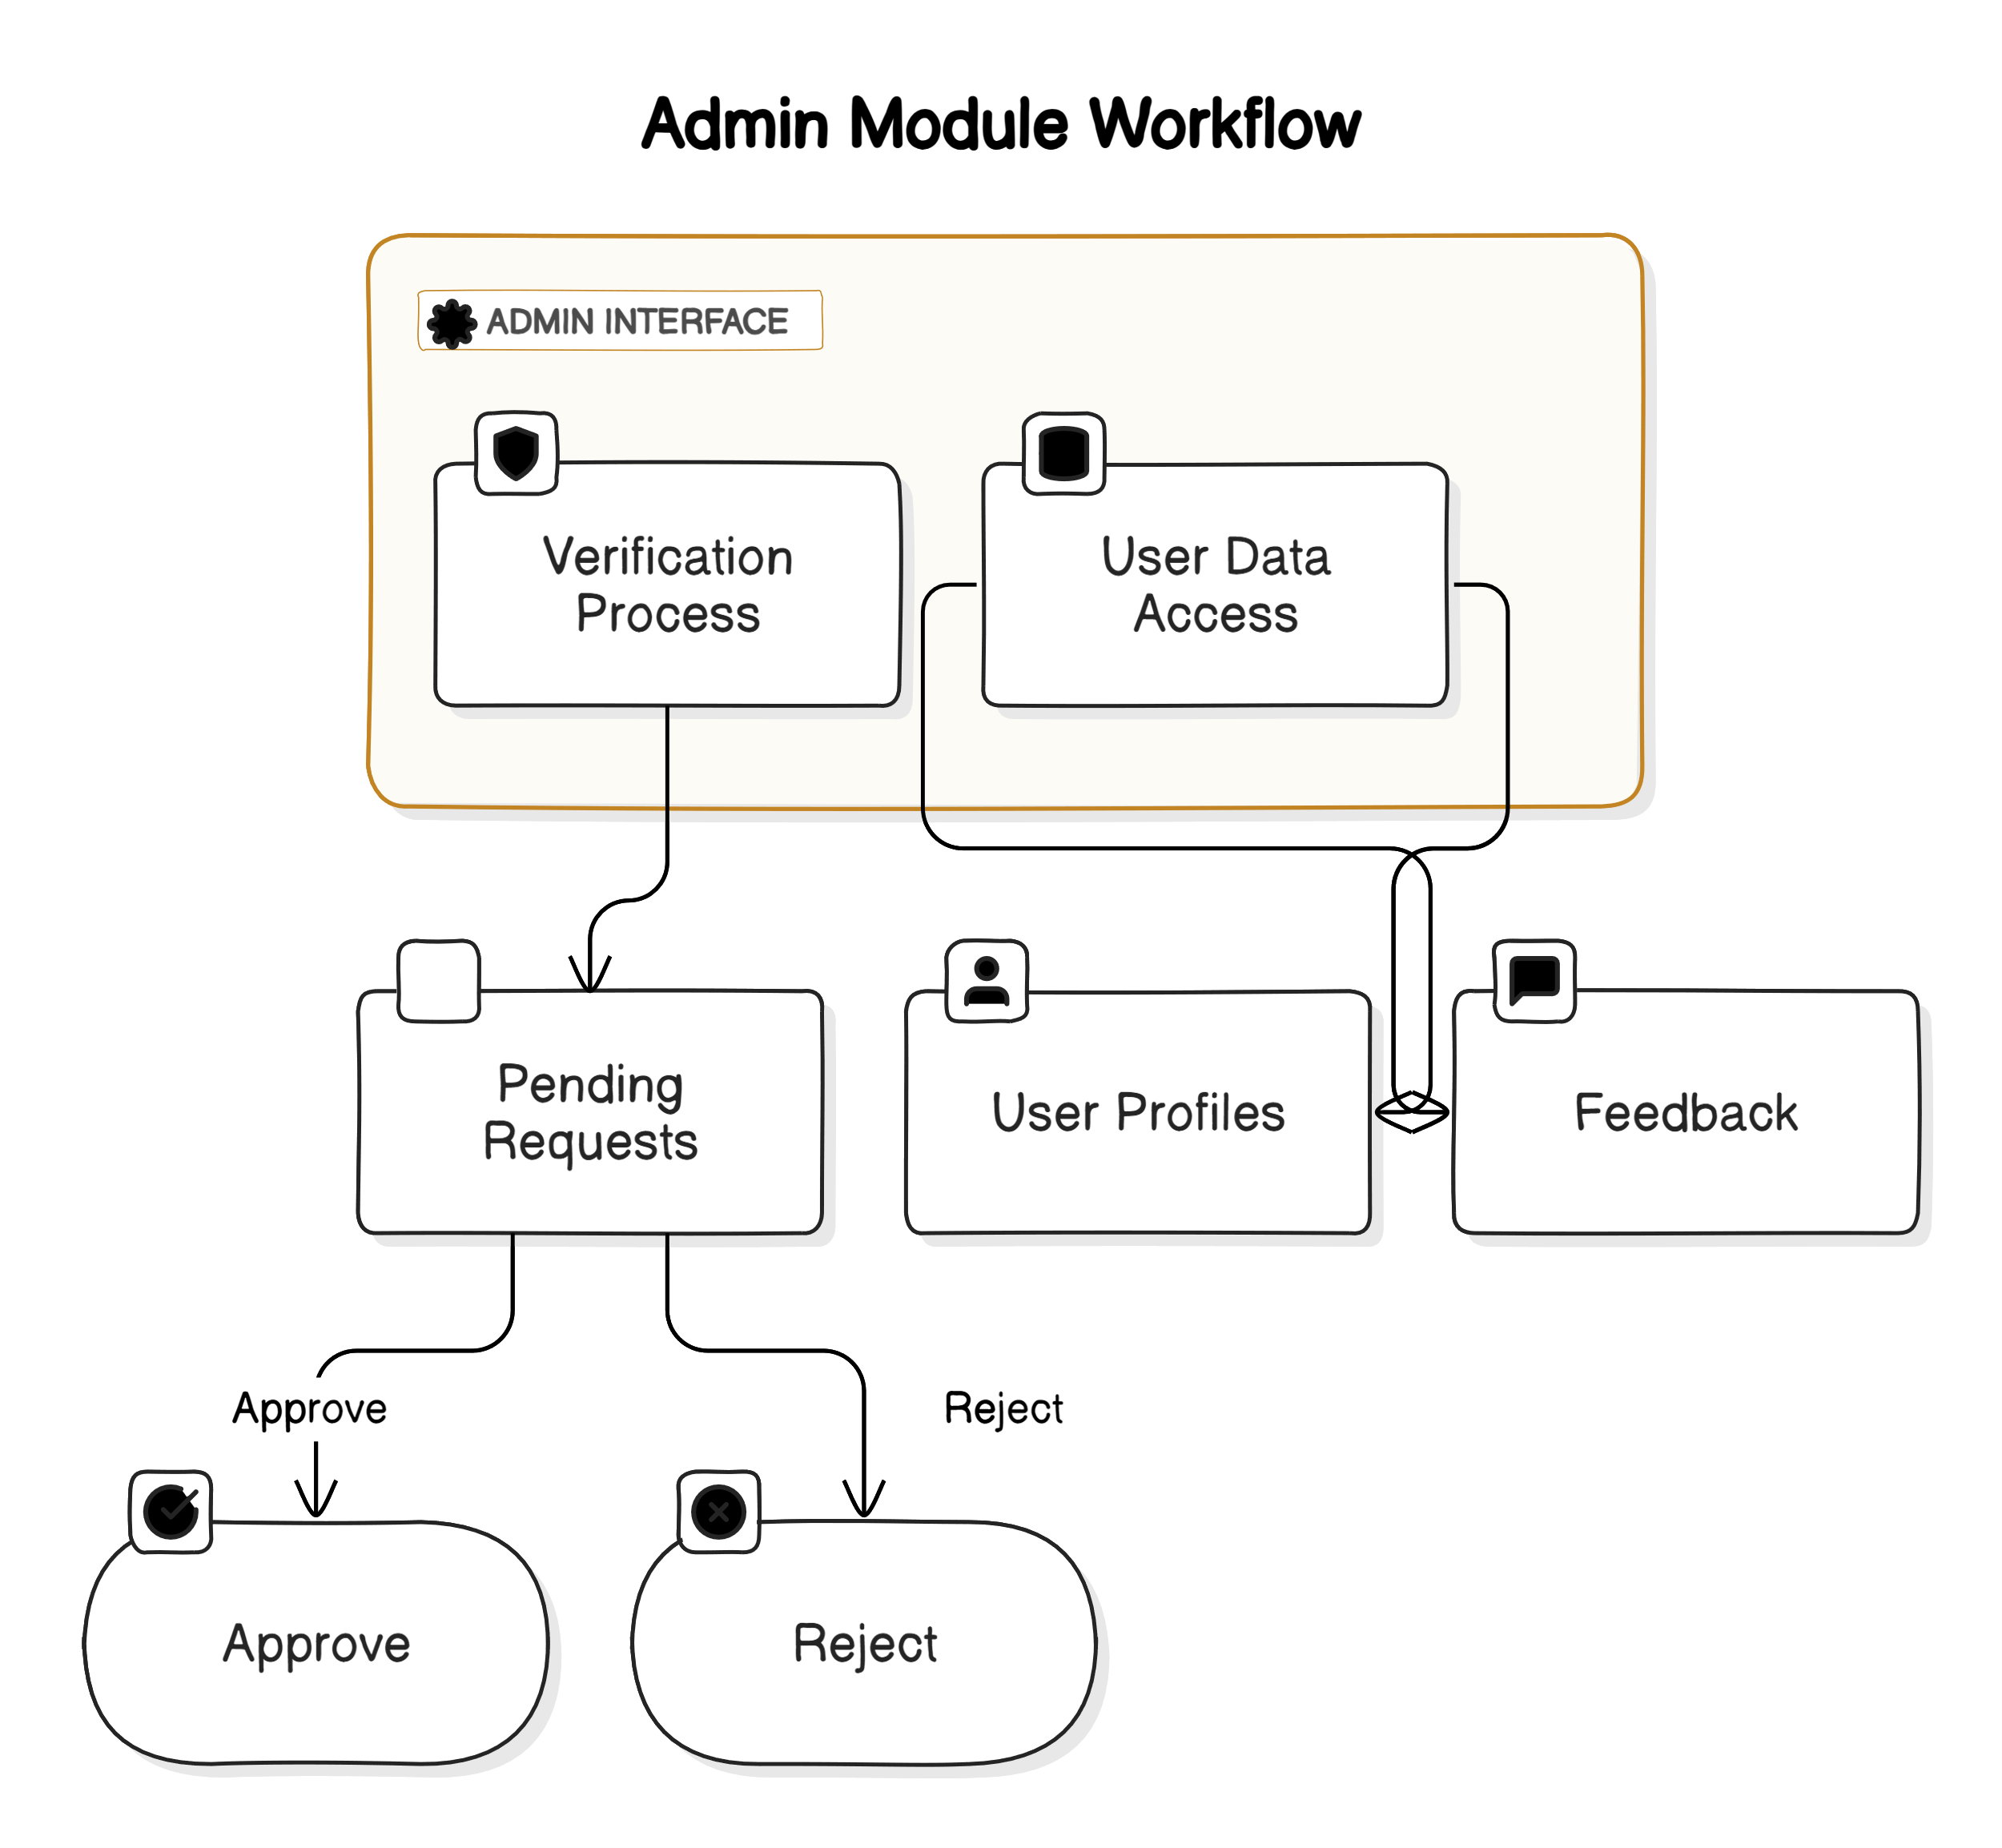
ADMIN Module
Users login by entering their username and password on the login page. Admins have the authority to approve or reject fuel stations, determining whether they are verified or not.

Slide 11
User Module
Users register with basic details to access the application service and log in subsequently. They can search for verified fuel stations based on their needs and place orders directly through the app. Payment integration allows users to pay via various platforms.

Slide 12
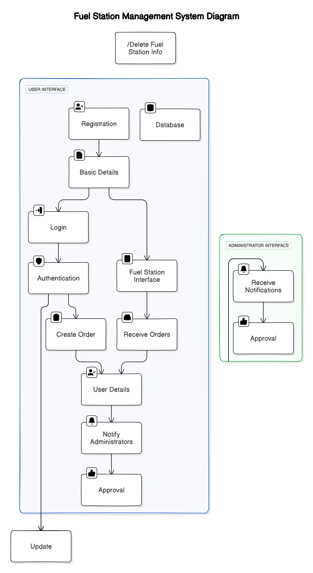

Slide 13

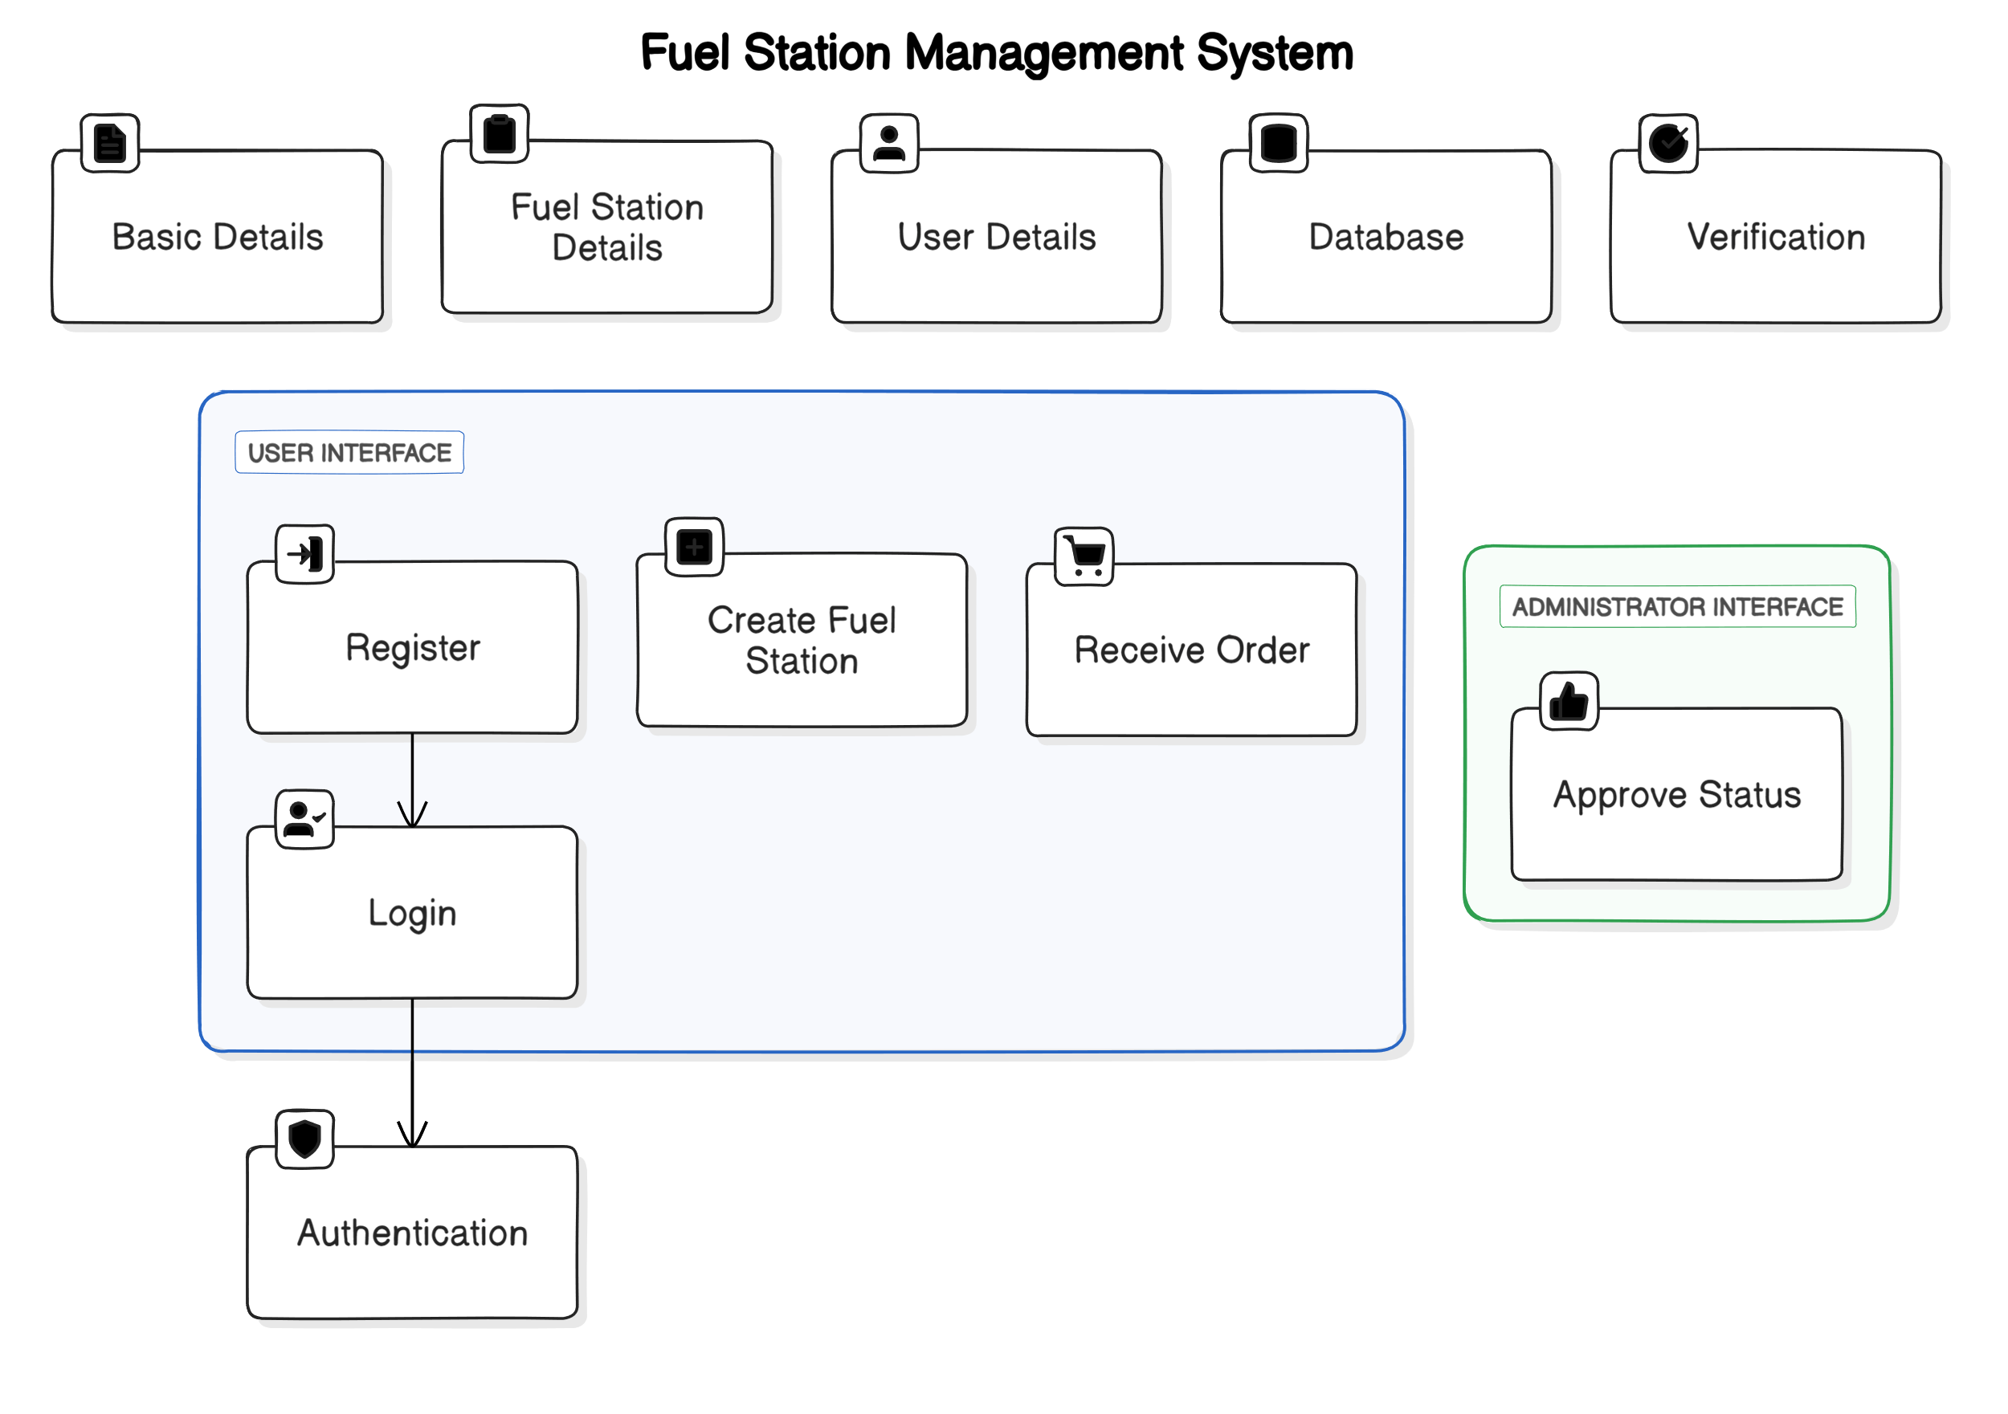
Fuel Station Module
Users register with basic details to access the service and log in thereafter. They create, update, or delete fuel station information, which is stored in the database. Orders are received from all areas, including user details, and stored. Administrators are notified for approval.

Slide 14
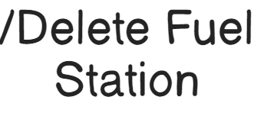




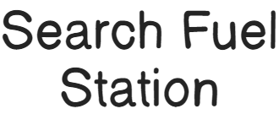
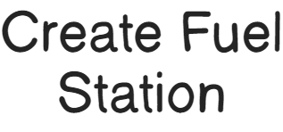







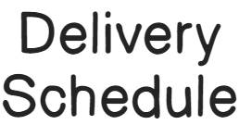


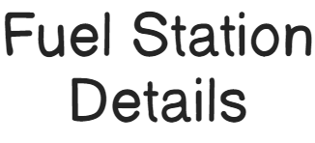



SYSTEM ARCHITECTURE
PDKVCET

Slide 15
SYSTEM REQUIREMENT
Hardware Requirements:-
Processor : Intel(R) 2.10GHz or above
Installed memory (RAM) : 4 GB
Hard Disk : 160 GB
Operating System : Windows (7,8,10&11)
Software Requirements: -
Front End: HTML5, CSS3, Bootstrap
Back End: PHP, MYSQL
Control End: Angular Java Script
PDKVCET

Slide 16
PDKVCET
LITERATURE SURVEY

Slide 17
PAPER 1:
Title : “Delivery Service Management System Using Google Maps for SMEs in
Emerging Countries”
Author : Sophea Horng and Pisal Yenradee
Year :2023.
Explanation:
This paper explores the rise of online map services using APIs like Google Maps and others, known as map "mashups." It highlights limitations in handling commercial databases and the lack of sophisticated functionalities in typical mashups. The paper presents a case study of an online map service for the USDA People's Garden Initiative, overcoming these limitations by integrating Google Maps API, Google Geocoder, Microsoft SQL database, Microsoft aspx.NET, and Spry Framework for Ajax. The application is compatible with major web browsers.
PDKVCET

Slide 18
API-driven Map Mashups: The paper explores the use of APIs like Google Maps in creating online map services, known as "mashups," for spatial applications.
Drawbacks Highlighted: It points out two main drawbacks of typical mashups - reliance on open-source methods for limited data preparation and a focus on quick delivery at the expense of advanced functionalities.
Case Study - USDA Garden Initiative: The paper showcases a case study developing an online map service for the USDA People's Garden Initiative, addressing limitations through technology integration, including Google Maps API and Microsoft SQL database, designed for compatibility with major web browsers.
PDKVCET

Slide 19
PAPER 2:
Title : “Real-time Tracking and Tracing System: Potentials for the Logistics Network”
Author : AHM Shamsuzzoha and Petri T Helo
Year :2023
Explanation:
This paper emphasizes the crucial role of tracking and tracing shipments for manufacturing firms, highlighting its significance in customer service and efficient logistics management. Global industries face coordination challenges in their product development sites due to issues in tracking and tracing within logistics networks. The paper proposes a technology-based approach to address these complexities, aiming to enhance the management of logistics networks by leveraging real-time shipment tracking in dispersed manufacturing environments. The objective is to explore and analyze new technological opportunities that can provide solutions for tracking and tracing distribution chains through emerging information technologies, particularly real-time tracking technologies.
PDKVCET

Slide 20
Focus: This project optimizes fuel distribution by solving the Vehicle Routing Problem, addressing challenges in product assignment, loading, and route planning.
Challenges: It deals with complex decisions under constraints like time, compartment limitations, and high-security conditions in a road network.
Objective: The goal is efficient fuel distribution using a limited fleet, particularly relevant for companies hiring vehicles and subcontracting replenishment to external transport providers.
PDKVCET

Slide 21
PAPER 3:
Title : “ANDROID APPLICATION FOR FUEL DELIVERY SYSTEM”
Author : Ayyan Abdul Hamid Fodkar , Khan Adil Parvez
Year :2023
Explanation:
The paper proposes the use of five supervised In response to the survey revealing that 36% of urban India's electricity is generated by diesel generators, a mobile fuel delivery application is proposed to transport 74 million liters of fuel, addressing accessibility challenges and catering to busy schedules. The Android app, developed with Java and XML, facilitates door-to-door fuel supply, offering user-friendly modules for order placement, tracking, and on-site assistance, while administrators can efficiently manage fuel station availability and additional services.
PDKVCET

Slide 22
Significance for Manufacturing Firms: Tracking and tracing shipments are crucial for manufacturing firms, playing a vital role in customer service and efficient logistics management.
Global Industry Challenges: Global industries face coordination problems in product development sites due to issues in tracking and tracing within logistics networks, highlighting the need for a sophisticated solution.
Technology-Based Approach: The paper proposes a technology-based methodology to address these challenges, focusing on real-time shipment tracking in dispersed manufacturing environments to enhance the overall management of logistics networks.
PDKVCET

Slide 23
PAPER 4:
Title : “A Comparative Study of Android Classifiers for Fuel Delivery App ”
Author : Mrs Sarita Singh, Singh Harshit Nagendra
Year :2022
Explanation:
The paper proposes the use of five supervised seems to describe an online fuel delivery application that addresses emergency situations when individuals are stranded without nearby petrol pumps. The application utilizes GPS for location tracking, offers multiple payment options including online gateways and pay-on-delivery, and emphasizes user security through individual accounts with unique IDs and passwords. Continuous performance improvement is highlighted by taking user reviews and ratings into account. The keywords include GPS and Payment Gateway, emphasizing the technological components of the proposed solution.
PDKVCET

Slide 24
Innovative Fuel Delivery Application: The paper introduces an online fuel delivery app leveraging GPS for location tracking, catering to emergencies when users are stranded without nearby petrol pumps.
Efficient Service: The system incorporates payment options, such as online gateways and pay-on-delivery, and prioritizes user reviews for continual performance improvement, ensuring secure transactions with individual accounts.
Keywords: Key elements include GPS for location, various payment gateways, and the emphasis on user security through individual accounts, enhancing the overall efficiency of the proposed online fuel delivery system.
PDKVCET

Slide 25
PAPER 5:
Title : “Fuel Indeed App ”
Author : Deepak Arvind Jadhav, Jayvant Madhukar Patil, Mayank Anil Patel, Nikhil Santosh Ingle, Prof. V.V. Mahale
Year :2022
Explanation:
The paper proposes the use of five supervised ntroduces a gasoline booking system called the "Petrol Indeed App" to address the challenges of fuel usage and the inconvenience of running out of fuel, especially in unfamiliar locations. The system enables users to order fuel from anywhere, providing a convenient solution for refueling without visiting gas stations. The app streamlines the booking process, enhances safety with a secured payment system, and aims to provide users with easy access to information, ultimately offering a user-friendly and efficient solution to fuel management..
PDKVCET

Slide 26
Fuel Booking Solution: The "Petrol Indeed App" is introduced as a gasoline booking system to alleviate challenges arising from increased fuel usage due to the rising number of automobiles in the market.
Convenience and Accessibility: The app aims to simplify the refueling process by allowing users to order fuel from any location, eliminating the need to visit gas stations. This not only enhances convenience for users but also enables the agency to efficiently manage bookings and monitor demand.
User-Friendly Interface: The system focuses on providing users with a straightforward interface for fuel booking, coupled with a secured payment process, ensuring a safe and accessible software solution for both clients and the agency.
PDKVCET

Slide 27
PAPER 6:
Title : “Smart Logistics and Supply Chain Management Implementation ”
Author : Ezar Amrullah
Year :2022
Explanation:
The paper proposes the use of The contemporary advancements in information and technology have significantly benefited science and its application in supply chain management. This has streamlined industrial processes, making it more attainable for all stakeholders to meet their objectives. This research employs a systematic literature review to investigate the historical implementation and role of IT in the context of supply chain management. The findings provide an insightful overview of IT utilization in supply chain management, while also suggesting potential avenues for future research.
PDKVCET

Slide 28
Information and technology advancements positively impact supply chain management, simplifying industrial processes and facilitating goal achievement for all parties involved.
A systematic literature review method was employed in this research to examine past studies on the implementation and role of IT in supply chain management.
The study results offer an overview of IT's use in supply chain management and suggest potential areas for future research in this domain.
PDKVCET

Slide 29
PAPER 7:
Title : “Location Based Services”
Author : Theodoros Oikonomidis
Year :2022
Explanation:
The paper proposes the use of Location Based Services (LBS) use smart device sensors for accurate positioning indoors and outdoors. With the growing importance of the Internet of Things (IoT), daily tasks rely on efficient service providers. This research aims to identify gaps in LBS, focusing on the Business and Management sector through a systematic review of the last 20 years of publications. The study reveals a lack of publications in this domain and emphasizes unexplored Grounded Theories, providing an opportunity for future research to expand on adoption and success in LBS for both academic and business communities.
PDKVCET

Slide 30
Location Based Services (LBS) utilize smart device sensors for accurate positioning indoors and outdoors, crucial for tasks dependent on IoT efficiency.
A systematic review of the last 20 years of publications reveals a lack of focus on the Business and Management sector in LBS research.
Identified gaps, particularly in Grounded Theories related to LBS adoption and success, present opportunities for future research to contribute new knowledge to both academic and business communities.
PDKVCET

Slide 31
PAPER 8:
Title : “Web-based Food Delivery Management System”
Author : Soni Fajar Surya Gumilang
Year :2022
Explanation:
The paper proposes the use of This study addresses the inefficiencies in the conventional meal ordering process within an organization, characterized by manual paper-based recording, data redundancy, and lack of reporting. It aims to introduce a web-based food delivery system named eatime! focusing on admin and financial sections. The application, developed using iterative-incremental methodology and PHP with CI framework, streamlines the ordering process, offers features such as food orders, menu search, balance viewing, transaction history recap, and sales report printing. Usability tests, conducted using the McCall method, assess the quality of the eatime! web application.
PDKVCET

Slide 32
Current meal ordering in the organization is manual and paper-based, causing issues like data redundancy and lack of reporting.
The study introduces "eati.me!", a web-based food delivery system, focusing on admin and financial aspects, developed using PHP with CI framework and MySQL database.
The application streamlines the ordering process with features like food orders, menu search, balance viewing, transaction history recap, and sales report printing, evaluated through usability tests using the McCall method.
PDKVCET

Slide 33
PAPER 9:
Title : “On-demand food delivery”
Author :Arianna Seghezzi, Matthias Winkenbach, Riccardo Mangiaracina
Year :2022
Explanation:
This paper has a dual purpose: firstly, reviewing academic literature on on-demand food delivery (ODFD) services from 2016 to 2020; secondly, proposing future research directions. Analyzing 59 papers, the review emphasizes the importance of an ecosystem-based perspective, increased focus on restaurant operations, and further exploration of human resource management and logistics in ODFD systems. The insights benefit both academics and practitioners, offering a comprehensive understanding of critical value-creating activities in ODFD businesses and suggesting avenues for future research.
PDKVCET

Slide 34
The paper reviews academic literature on on-demand food delivery (ODFD) services, highlighting the industry's complexity and academic interest.
Findings emphasize the need for an ecosystem-based perspective, increased attention to restaurant operations, and further exploration of human resource management and logistics in ODFD systems.
The insights from the review benefit both academics and practitioners, providing a comprehensive understanding of critical value-creating activities in ODFD businesses and suggesting directions for future research
PDKVCET

Slide 35
PAPER 10:
Title : “Cost and Performance Optimisation in the Technological Phase of Parcel Delivery ”
Author :Ermin Muharemović
Year :2022
Explanation:
This review systematically explores existing research on cost and performance optimization in parcel delivery, particularly focusing on the challenges posed by globalization and the growing trend of online selling. The study highlights that the technological phase of parcel delivery incurs the greatest costs and is the least efficient. Researchers are addressing this challenge through algorithm-based technologies, logistic innovations, and outsourcing to enhance delivery efficiency, improve performance, and optimize costs. The paper aims to provide a comprehensive overview of recent research in technology, innovations, and outsourcing models to reduce costs and enhance productivity and quality in parcel delivery.
PDKVCET

Slide 36
The review paper examines current research on optimizing costs and performance in parcel delivery, addressing challenges driven by globalization and the rise of online selling.
It emphasizes that the technological phase of parcel delivery incurs significant costs and is the least efficient, prompting researchers to explore solutions such as algorithm-based technologies, logistics innovations, and outsourcing.
The paper aims to provide a systematic overview of recent studies in technology, innovations, and outsourcing models, focusing on reducing costs and enhancing productivity and quality in the parcel delivery phase.
PDKVCET

Slide 37
SYSTEM DESIGN
USE CASE DIAGRAM:
A use case diagram is a type of behavioral diagram created from a Use-case analysis. The purpose of use case is to present overview of the functionality provided by the system in terms of actors, their goals and any dependencies between those use cases.
PDKVCET

Slide 39
CLASS DIAGRAM:
A class diagram in the UML is a type of static structure diagram that describes the structure of a system by showing the system’s classes, their attributes, and the relationships between the classes.
PDKVCET

Slide 40
SEQUENCE DIAGRAM:
A sequence diagram in UML is a kind of interaction diagram that shows how the processes operate with one another and in what order.
PDKVCET

Slide 41
ACTIVITY DIAGRAM:
Activity diagram are a loosely defined diagram to show workflows of stepwise activities and actions, with support for choice, iteration and concurrency. UML, activity diagrams can be used to describe the business and operational step-by-step workflows of components in a system.
PDKVCET

Slide 42
Collaboration Diagram:
A collaboration diagram is a type of visual presentation that shows how various software objects interact with each other within an overall IT architecture and how users can benefit from this collaboration
PDKVCET

Slide 43
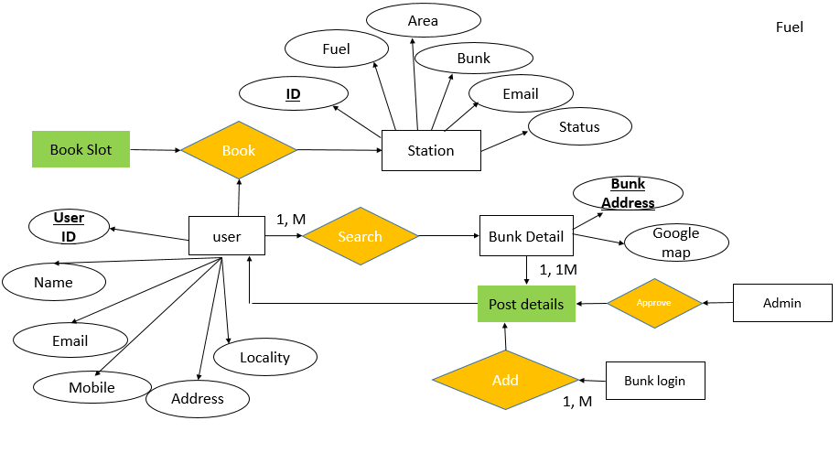
ER Diagram:
PDKVCET

Slide 44
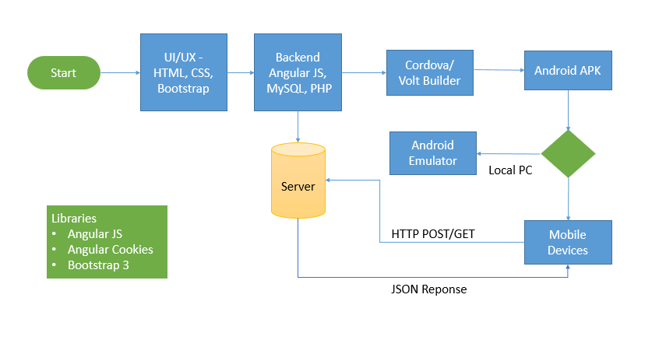
Work Flow Diagram:
PDKVCET

Slide 45
Data Flow Diagram:
User
User
Login
PDKVCET
Search Fuel Station
Place Order
Database
Make Payment & Get delivery

Slide 46
Data Flow Diagram:
Fuel Station
PDKVCET
Admin
Login
Create Fuel Station
Update/Delete Fuel Station
Receive order
Approve Status
Database

Slide 47
Data Flow Diagram:
Admin
Admin
Login
PDKVCET
Approve/Reject Fuel Station
Database

Slide 48
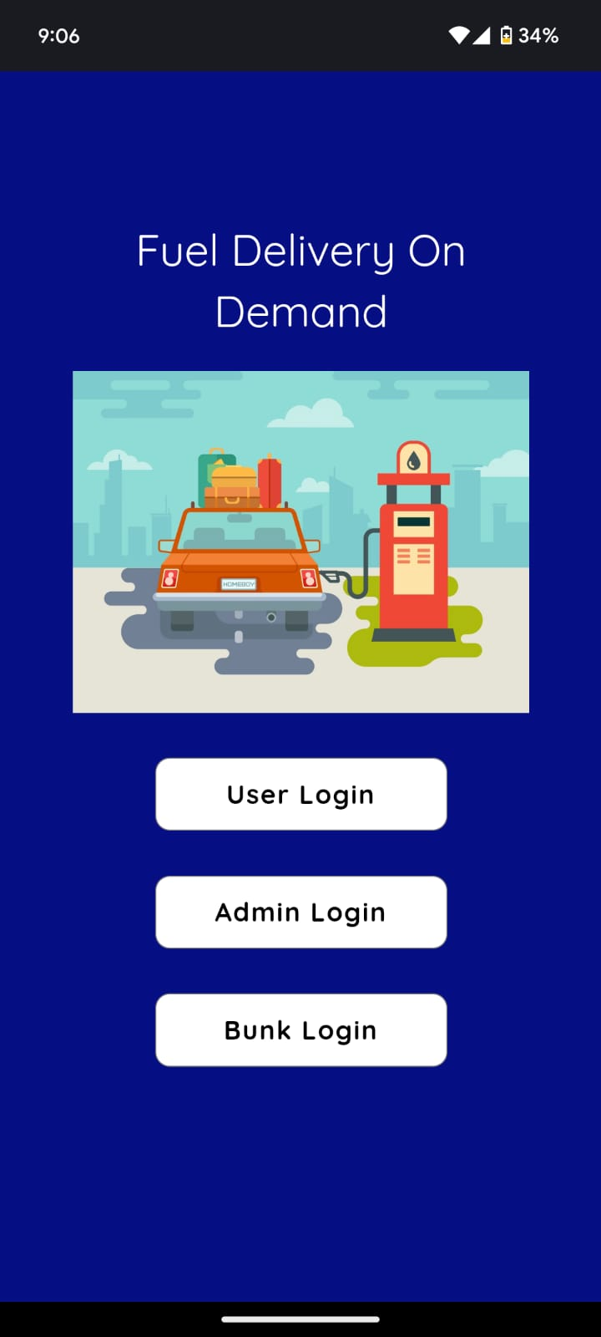
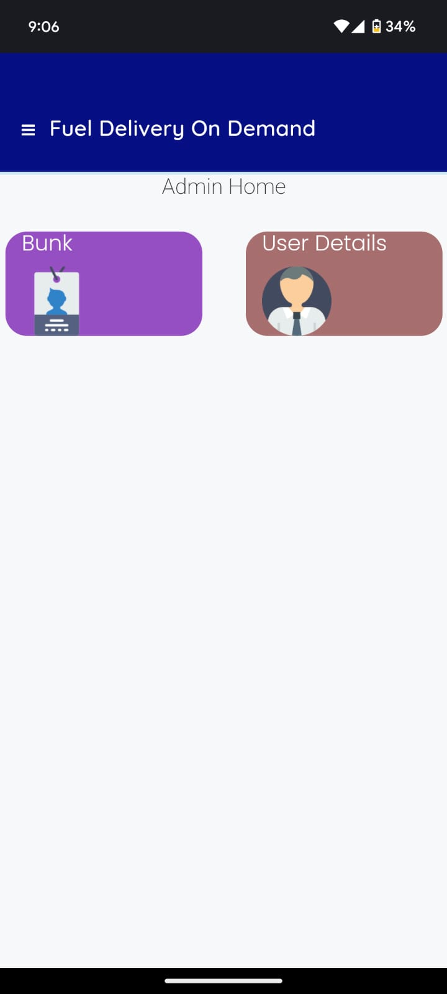
SCREEN SHOTS

Slide 49
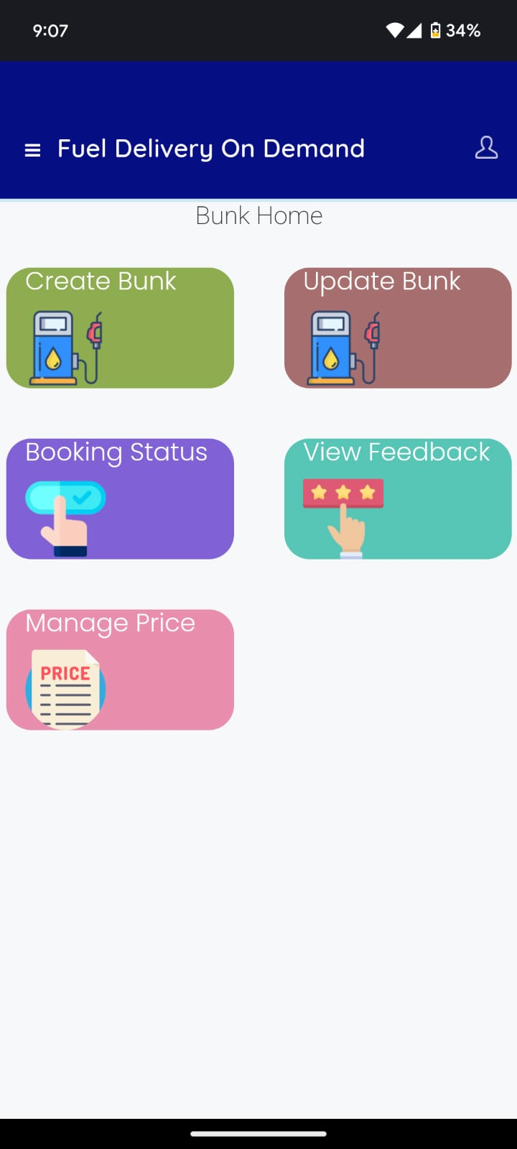
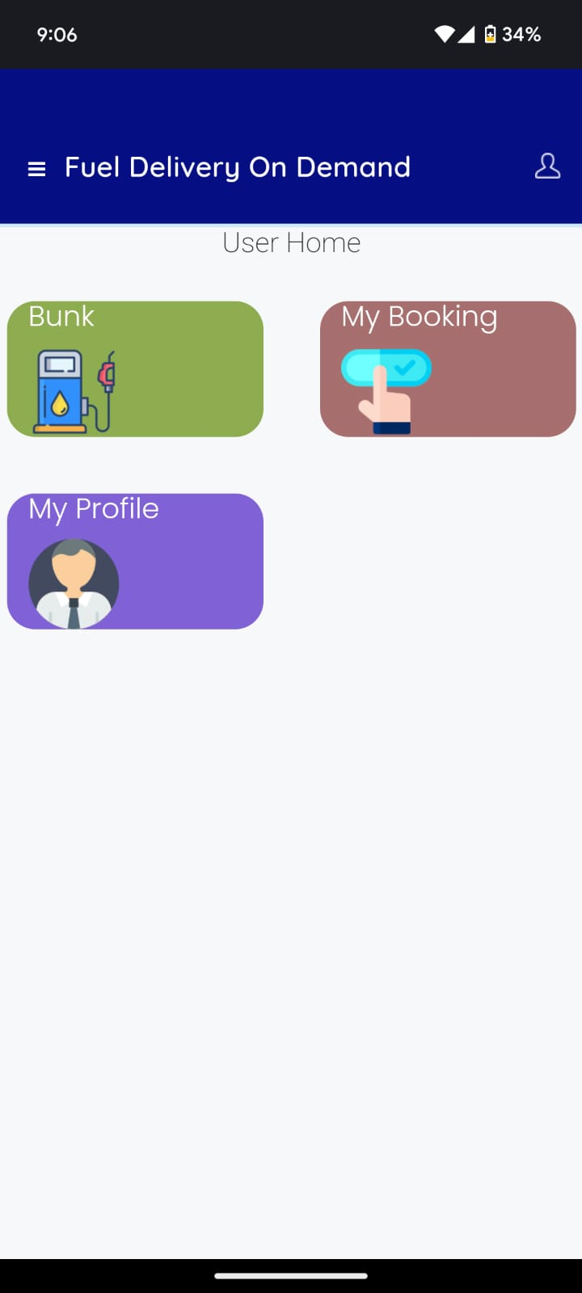

Slide 50
REFERENCES
[1] Wiriasto, G.W., Aji, R.W.S., Budiman, D.F.: Design and development of attendance system application using android-based flutter. In: 2020 Third International Conference on Vocational Education and Electrical Engineering (ICVEE), pp. 1–6 (2023)
[2] Ameen, S.Y., Mohammed, D.Y.: Developing cross-platform library using flutter. Eur. J. Eng. Technol. Res. 7(2), 18–21 (2022)
[3] Sharpe, R.G., de Bruin, T.: Fuel delivery system modeling for high-pressure common rail diesel engines. J. Eng. Gas Turbines Power 136(6), 061505 (2022)
[4] Kuo, Y.S., Chen, W.L.: Design and optimization of a fuel delivery system for a diesel engine using CFD simulation and RSM methodology. Energies 9(11), 918 (2022)
[5] Manh, N.P., Jeong, H.G.: Modeling and control of a fuel delivery system for gasoline engines. Energies 10(8), 1221 (2022)
PDKVCET

Slide 51
REFERENCES
[6] Williams, T.M., Pearson, J.M.: Fuel Delivery Systems for Gasoline Direct Injection Engines. SAE Technical Paper, 2018–01–0312 (2022)
[7] Wang, J., Liu, J., Huang, Q.: Design of a fuel delivery system for high-speed diesel engine based on digital simulation technology. Int. J. Automot. Technol. 22(3), 1045–1056 (2021)
[8] Huang, K., Xie, S., Wang, X., Sun, L.: Design and simulation of a fuel delivery system for a variable compression ratio engine. Energies 13(22), 6029 (2021)
[9] Gao, H., Liu, J., Huang, Q.: Fault diagnosis of fuel delivery system for diesel engine based on dynamic Bayesian network. J. Mech. Sci. Technol. 33(5), 2245–2253 (2021)
[10] Rabinovich, A., Azuri, Y., Shtilman, L.: Assessment of fuel delivery system of a high-performance UAV engine. J. Propul. Power 34(4), 880–888 (2021)
PDKVCET

Slide 52
PDKVCET
QUERY

Slide 53
PDKVCET
THANK YOU

